Slide 1
NIOS II EMULATOR Increment 4 Retrospective
Team 12
Team Members
Jake Ediger
Alex Michael
Alex Czarnick
Avinash Nooka
Raksharth Choudhary

Slide 2
Overview
Project Description
Architecture
Detailed Design
Class Diagrams
Sequence Diagrams
Implementation
Demo
Reflection

Slide 3
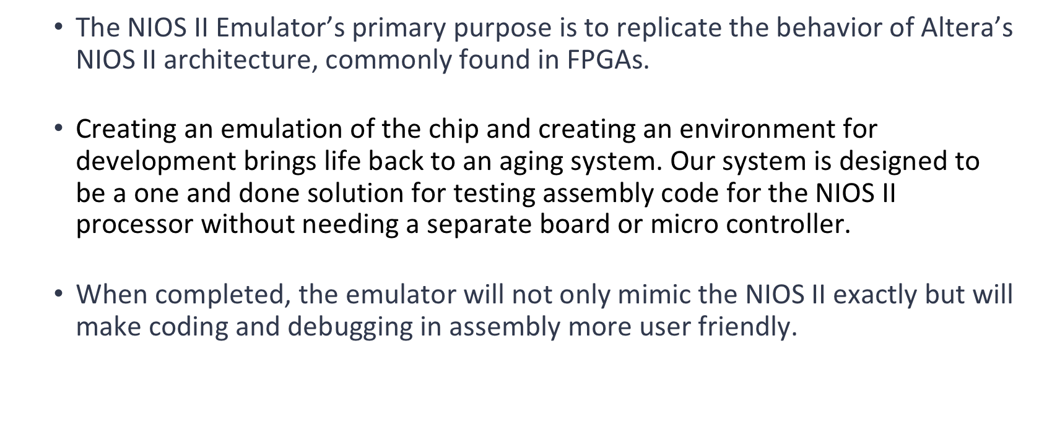
Project Overview

Slide 4
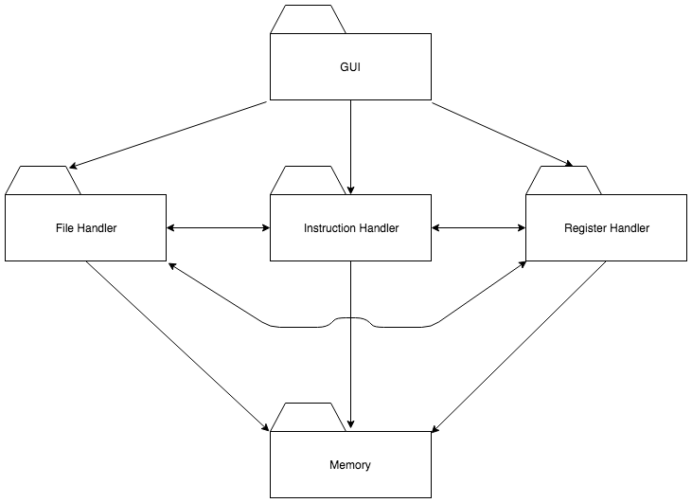
Architecture

Slide 5
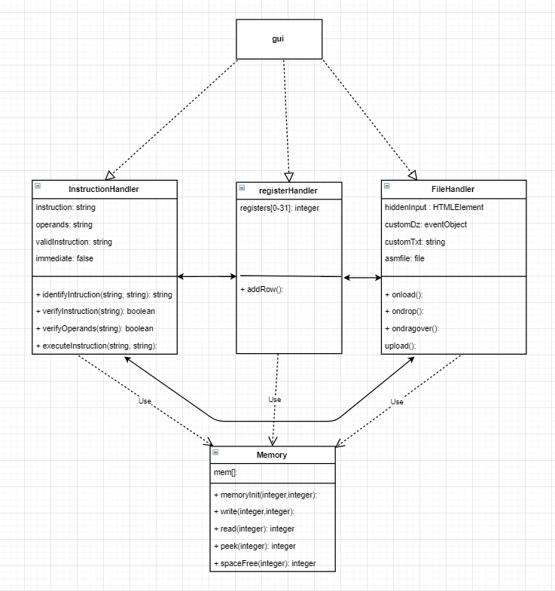
Class Diagram

Slide 6
Class Diagram: Instruction Handler

Slide 7
Class Diagram: Register Handler

Slide 8
Class Diagram: File Handler

Slide 9
Class Diagram: Memory

Slide 10
Sequence Diagram: File Reader

Slide 11
Sequence Diagram: GUI

Slide 12
Implementation
Target Platform
Web application
Language
Javascript, HTML, CSS
Libraries
Progress

Slide 13
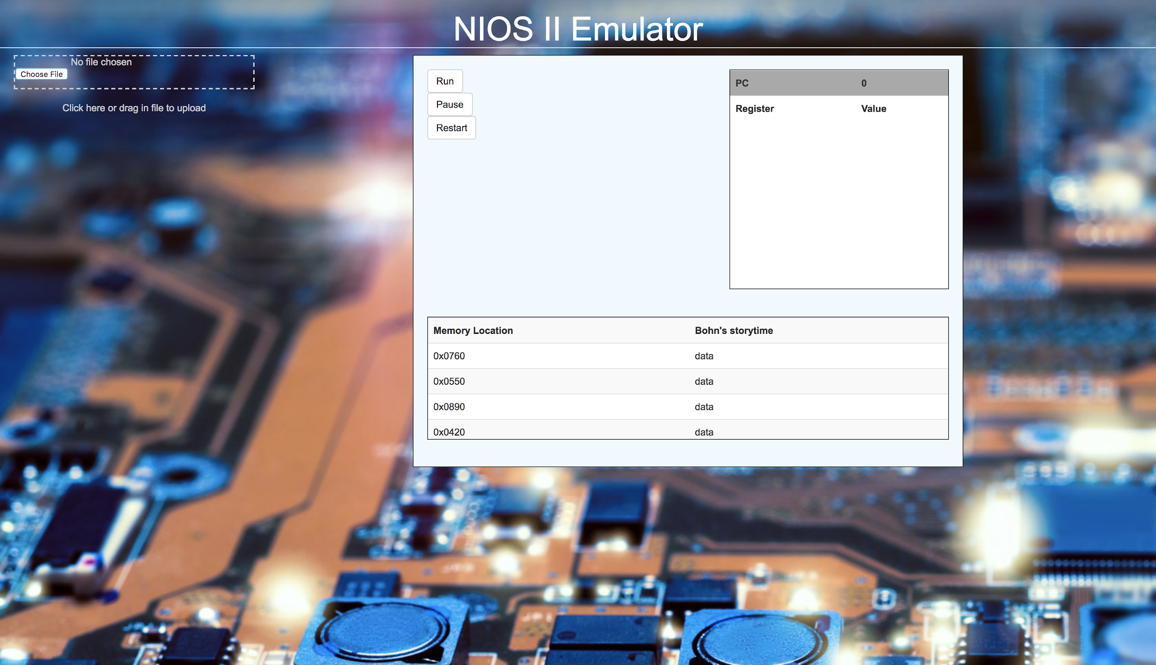
Demo: Main Screen

Slide 14
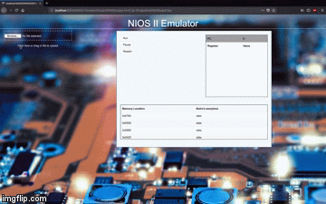
Demo: Uploading file

Slide 15
Reflection
What went well
The coding portion of this increment went very well. Work was split up and we were able to get the basic parts put in relatively quickly and without git problems.
Our last version of the SDD was good enough that we didn’t need to stray from it to put in the basic parts, although changes might still be required later as each component is further developed.

Slide 16
Reflection
What didn’t go well
It was not clear how to go about doing our class and sequence diagrams, as Javascript has a few different attributes that makes it a little more difficult to see things from an overhead view.
A few of the components could be developed very much since they rely on an input file to be parsed, which was not put in this increment.

Slide 17
Reflection
Something to improve
When coding the next increment, taking a strategy of doing the most integral parts first would allow us to proceed to other components easier.
We should have referred to the NIOS II docs before starting the implementation of execution of instructions, as it would have given us insight into how instructions/registers interact between our components.

